Slide 1

ERP Application for business management
Author: Tural Hajiyev

Slide 2
The subject of the project
Handle your relations, stocks, products, and business operations from online application;
Access your business from everywhere without any application requirement;
Store and process all data in one place, which makes generating reports and calculations easier.

Slide 3
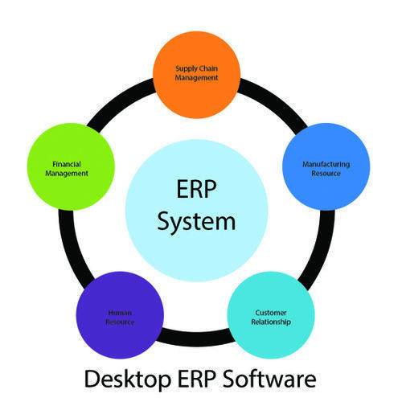
Justification
Why are you going to do it?
Make your business more agile;
Save on unnecessary costs;
Avoid data lost;
Improve security and; accessibility;
Grow your business;

Slide 4
Project scope and risks
Scopes
Risks
Manage all business from one point;
Access your data from anywhere;
Store all of your sensitive data in one place;
Use data of different modules to create relational processes;
contacts + products = trade operations.
Lack of integration;
Keep performance up to date;
Lack of business knowledge;

Slide 5
Features to be implemented
Primary (must have)
Secondary (extended)
Users – Create, Update and Delete users who can access to tenant.
Relations – Create, Update and Delete contact and partner lists.
Warehouse – List of stocks and products of company
Authentication and Authorization system
Operations – Create Trade and Finance operations which are related with contact lists (Relations module) and products (Warehouse module)

Slide 6
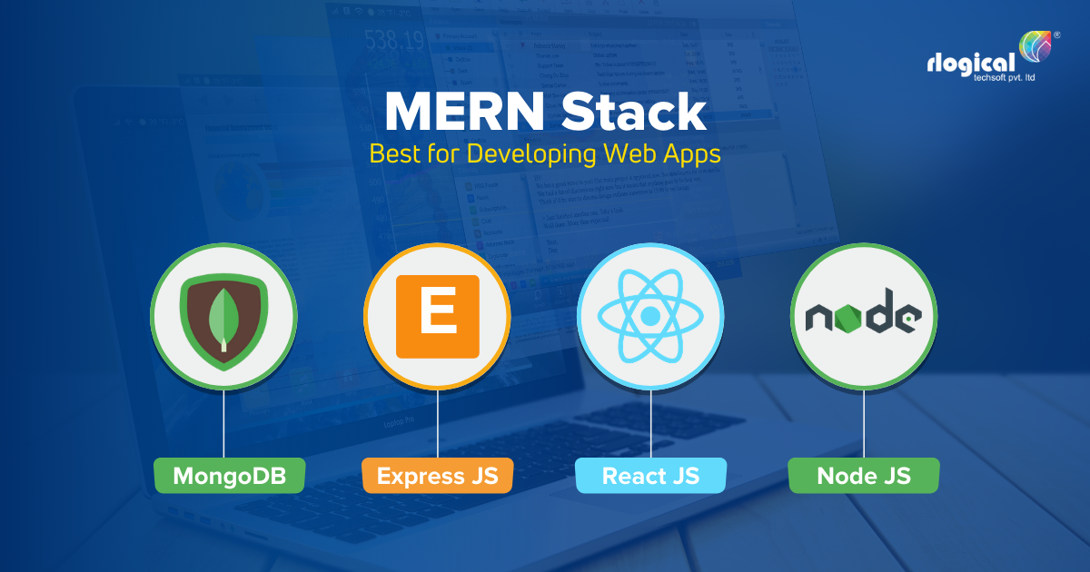
Techniques & Technologies
What stack are you going to use?

Slide 7
Deployment & hardware requirements
Install / Deploy technologies
Hard / Software requirements
npm
docker
Heroku / AWS
laptop or pc;
> 4gb rams;
internet connection;
stable browser – google chrome, mozilla, opera, safari;

Slide 8
State of Art
Microsoft Dynamics - It helps users run their business and improve their results using artificial intelligence-driven insights.
SAP - SAP Business One is a comprehensive ERP application that helps users manage all aspects of their business affordably.
Acumatica - This application is going to be cloud app, what means that managers can access their businesses from anywhere if they have internet connection.
Micro, ERPNext, odoo, Oracle NET Suite, etc.

Slide 9
Milestones
First month
Authentication / Authorization
Users module
Second month
Relations module
Stocks module
Third month
Trade operations
Unit testing
Deployment

Slide 10
References
https://www.netsuite.com/portal/resource/articles/erp/erp-modules.shtml
https://www.algonquincollege.com/erp/home/objectives/
https://www.selecthub.com/erp-software/
https://blog.datixinc.com/blog/erp-goals
https://www.panorama-consulting.com/erp-project-scope/
https://www.oracle.com/erp/what-is-erp/
https://trello.com/b/IgG9bK96/itappodmon0730
https://github.com/turalowski

